Slide 1
Topic: Congruence EQ: How can we prove two triangles are congruent?
Year 8

Slide 2
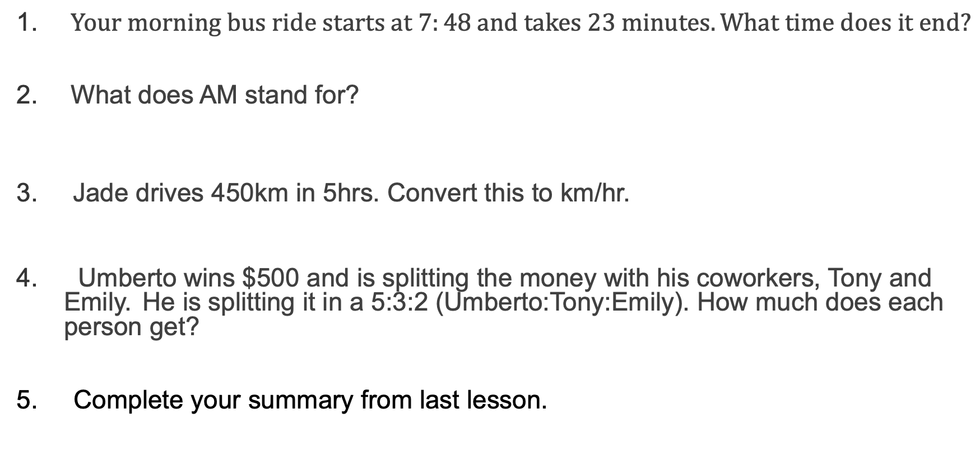
5 Questions
Topic: Congruency
EQ: How do I know if two shapes are congruent?
$Your morning bus ride starts at 7:48 and takes 23 minutes. What time does it end?$
What does AM stand for?
Jade drives 450km in 5hrs. Convert this to km/hr.
Umberto wins $500 and is splitting the money with his coworkers, Tony and Emily. He is splitting it in a 5:3:2 (Umberto:Tony:Emily). How much does each person get?
5. Complete your summary from last lesson.

Slide 3
24
7
30
Topic: Congruence
Date:
EQ – How can we prove two triangles are congruent?
What are Congruent Shapes?
Congruent shapes have the same shape and size. They can fit exactly on top of each other.
There are 4 rules we can use to show congruence.

Slide 4
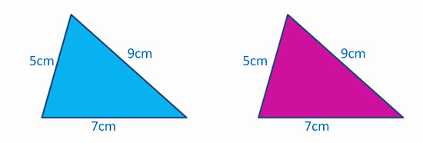
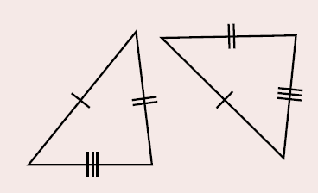
SSS Rule
Side, Side, Side Rule
Congruent if all three sides of the triangles are equal in length
Notes:
Guide students through the question.
Option 2: Dot plots handout (Scaffolded for kids who may need extra help)

Slide 5
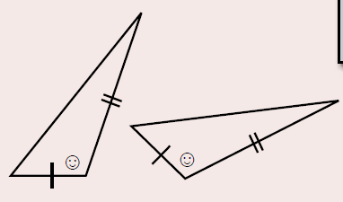
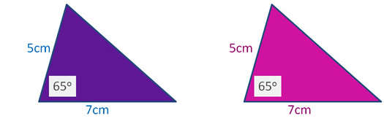
SAS Rule
Side, Angle, Side Rule
Congruent if two matching sides have equal lengths, and the angle in between these two sides is the same
Notes:
Guide students through the question.
Option 2: Dot plots handout (Scaffolded for kids who may need extra help)

Slide 6
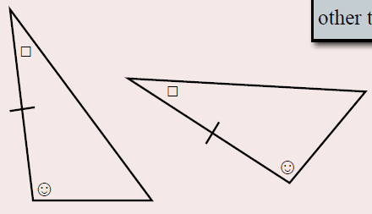
ASA Rule
Angle, Side, Angle Rule
Congruent if two angles are the same and the side length in between the angles is the same
Notes:
Guide students through the question.
Option 2: Dot plots handout (Scaffolded for kids who may need extra help)

Slide 7
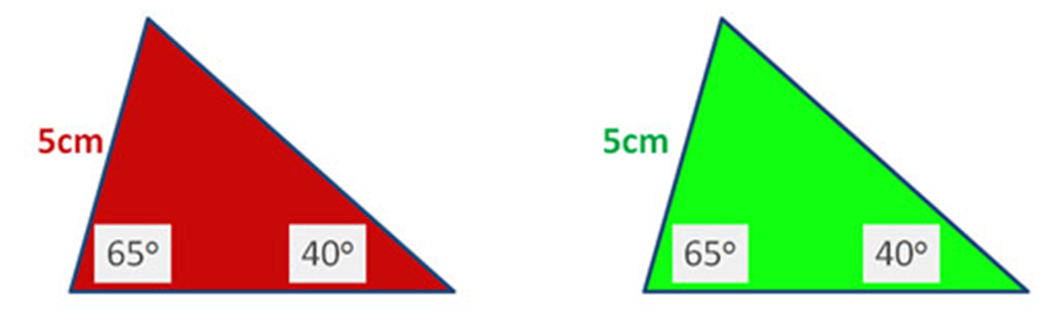
AAS Rule
Angle, Angle, Side Rule
Congruent if two angles are the same and one side is matching
Notes:
Guide students through the question.
Option 2: Dot plots handout (Scaffolded for kids who may need extra help)

Slide 8
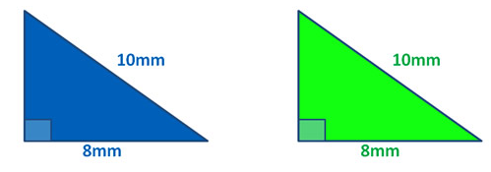
RHS Rule
Right-Angle, Hypotenuse, Side Rule
Congruent if the hypotenuse and one matching side are equal in length. They also have a 90° angle equal.
Notes:
Guide students through the question.
Option 2: Dot plots handout (Scaffolded for kids who may need extra help)

Slide 9
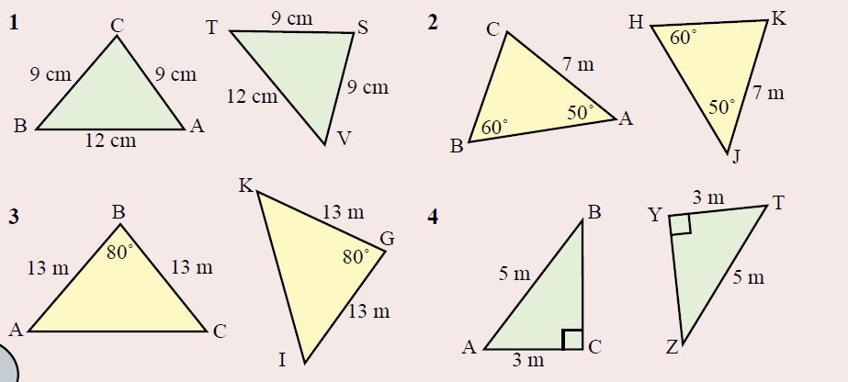
Practice
Notes:
Guide students through the question.
Option 2: Dot plots handout (Scaffolded for kids who may need extra help)

Slide 10

Notes:
Move to Freefall worksheet congruence statements

Slide 11
Task
Complete the activity sheet as your exit pass
(The HL column is the same as the RHS rule)
Get your teacher to check that you are correct before you glue in the triangles!!
Notes:
Guide students through the question.
Option 2: Dot plots handout (Scaffolded for kids who may need extra help)

